Slide 1


Data and Computer
Communications
Signal Encoding Techniques

Slide 2
Encoding Techniques
• Digital data, digital signal
• Analog data, digital signal
• Digital data, analog signal
• Analog data, analog signal

Slide 3
Digital Data, Digital Signal
• Digital signal
—Discrete, discontinuous voltage pulses
—Each pulse is a signal element
—Binary data encoded into signal elements

Slide 4
Terms (1)
• Unipolar
—All signal elements have same sign
• Polar
—One logic state represented by positive voltage the
other by negative voltage
• Data rate
—Rate of data transmission in bits per second
• Duration or length of a bit
—Time taken for transmitter to emit the bit

Slide 5
Terms (2)
• Modulation rate
—Rate at which the signal level changes
—Measured in baud = signal elements per second
• Mark and Space
—Binary 1 and Binary 0 respectively

Slide 6
Interpreting Signals
• Need to know
—Timing of bits - when they start and end
—Signal levels
• Factors affecting successful interpreting of
signals
—Signal to noise ratio
—Data rate
—Bandwidth

Slide 7
Comparison of Encoding
Schemes (1)
• Signal Spectrum
—Lack of high frequencies reduces required bandwidth
—Concentrate power in the middle of the bandwidth
• Clocking
—Synchronizing transmitter and receiver
—External clock
—Sync mechanism based on signal

Slide 8
Comparison of Encoding
Schemes (2)
• Error detection
—Can be built in to signal encoding
• Signal interference and noise immunity
—Some codes are better than others
• Cost and complexity
—Higher signal rate (& thus data rate) lead to higher
costs
—Some codes require signal rate greater than data rate

Slide 9
Encoding Schemes
• Nonreturn to Zero-Level (NRZ-L)
• Nonreturn to Zero Inverted (NRZI)
• Bipolar -AMI
• Pseudoternary
• Manchester
• Differential Manchester
• B8ZS
• HDB3

Slide 10
• NRZ-L
0=High Level. 1= Low Level
• NRZI
0= No Transition at beginning. 1= Transition.
• Bipolar-AMI
0= No signal.
1=Positive or negative level, altering successively.
• Pseudoternary
0=Positive or Negative Level
1= No Signal.

Slide 11
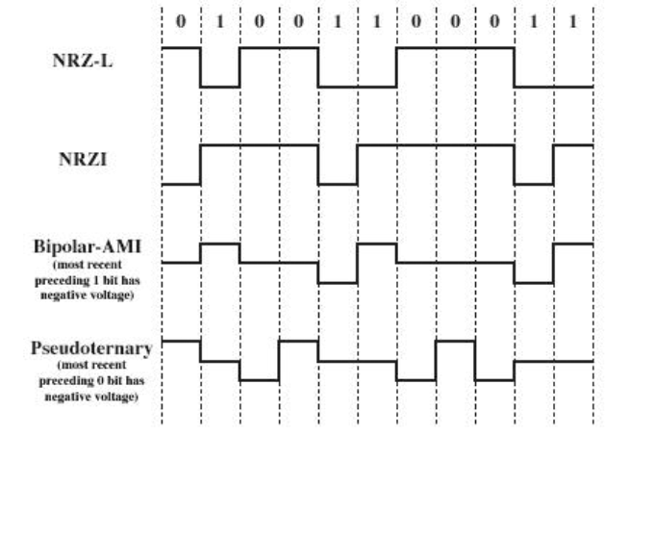

Slide 12
Differential Encoding
• Data represented by changes rather than levels
• More reliable detection of transition rather than
level
• In complex transmission layouts it is easy to
lose sense of polarity

Slide 13
• Manchester
0= Transition from high to low in middle of
interval.
1= Transition from low to high in middle of
interval.
• Differential Manchester.
Always a transition in middle.
0= Transition at beginning of interval.
1= No Transition at beginning of interval.

Slide 14
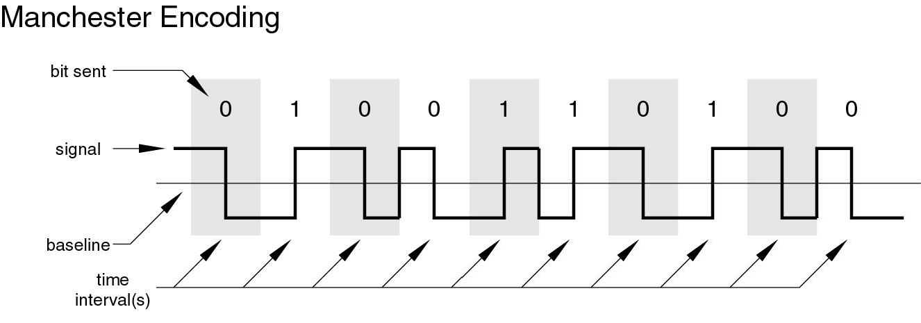
Manchester Encoding

Slide 15
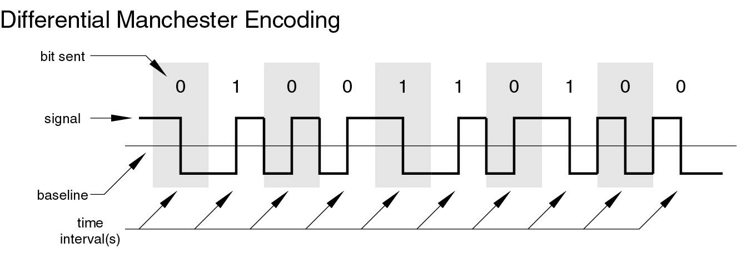
Differential Manchester
Encoding

Slide 16
Biphase Pros and Cons
• Con
—At least one transition per bit time and possibly two
—Maximum modulation rate is twice NRZ
—Requires more bandwidth
• Pros
—Synchronization on mid bit transition (self clocking)

Slide 17
B8ZS
• Bipolar With 8 Zeros Substitution
• Based on bipolar-AMI

Slide 18
HDB3
• High Density Bipolar 3 Zeros
• Based on bipolar-AMI
• String of four zeros replaced with one or two
pulses

Slide 19
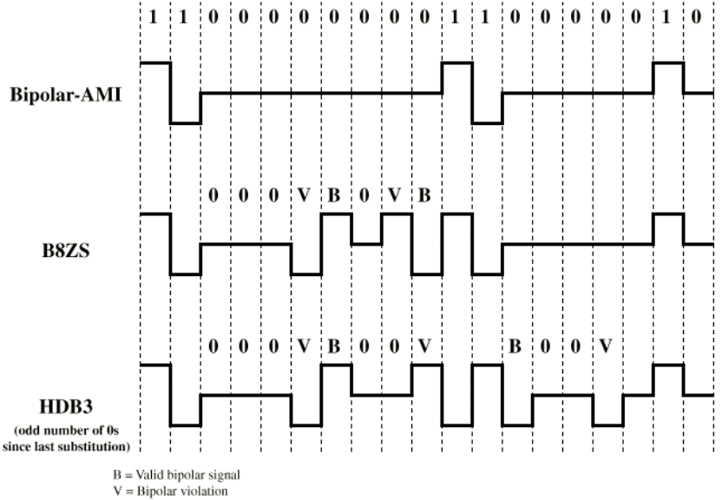
B8ZS and HDB3
Notes:
Last Pulse +ve:000+-0-+
Last Pulse –ve:000-+0+-

Slide 20
Digital Data, Analog Signal
• Public telephone system
—300Hz to 3400Hz
—Use modem (modulator-demodulator)
• Amplitude shift keying (ASK)
• Frequency shift keying (FSK)
• Phase shift keying (PK)

Slide 21


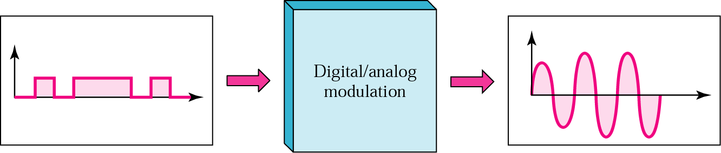
Digital-to-analog modulation

Slide 22
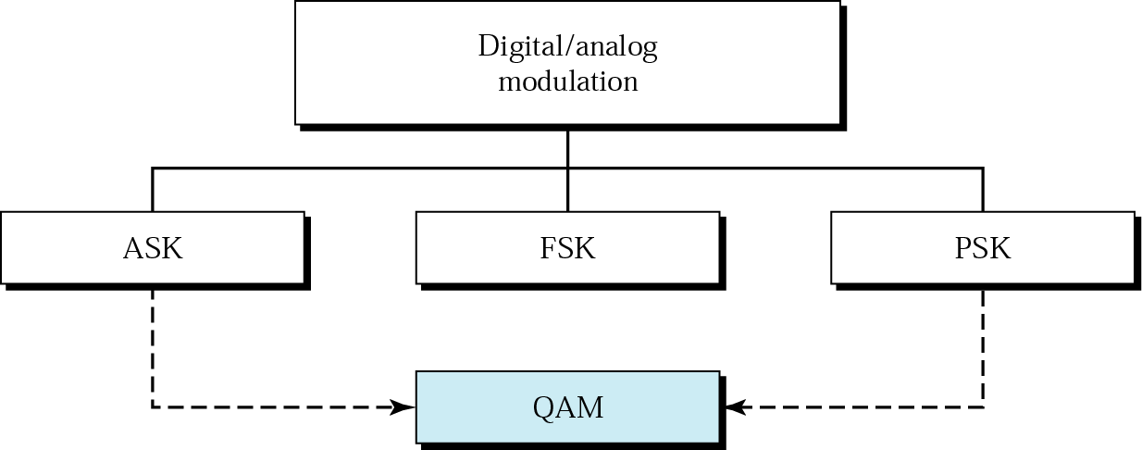
Figure 5.2
Types of digital-to-analog modulation

Slide 23

Note:
Bit rate is the number of bits per second. Baud rate is the number of signal units per second. Baud rate is less than or equal to the bit rate.

Slide 24
Example 1
An analog signal carries 4 bits in each signal unit. If 1000 signal units are sent per second, find the baud rate and the bit rate
Solution
Baud rate = 1000 bauds per second (baud/s) Bit rate = 1000 x 4 = 4000 bps

Slide 25
Example 2
The bit rate of a signal is 3000. If each signal unit carries 6 bits, what is the baud rate?
Solution
Baud rate = 3000 / 6 = 500 baud/s

Slide 26
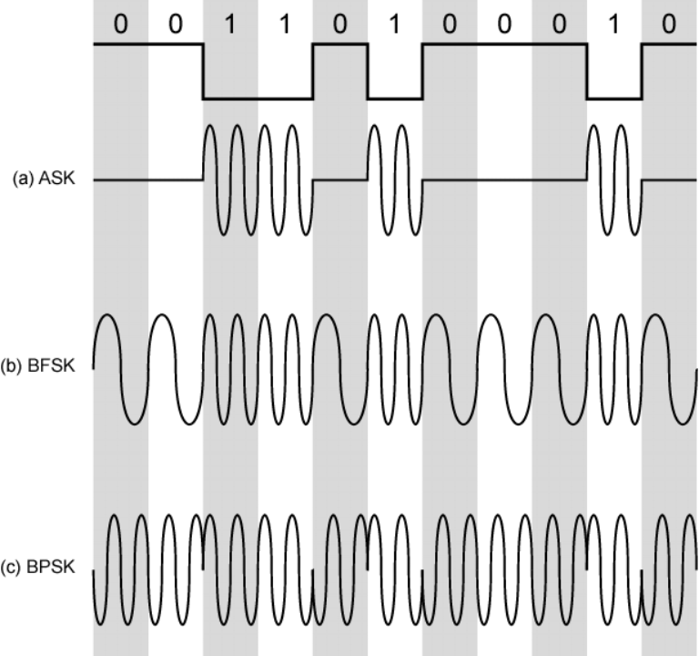
Modulation Techniques

Slide 27
Amplitude Shift Keying
• Values represented by different amplitudes of
carrier
• Usually, one amplitude is zero
—i.e. presence and absence of carrier is used
• Susceptible to sudden gain changes
• Inefficient
• Up to 1200bps on voice grade lines
• Used over optical fiber

Slide 28
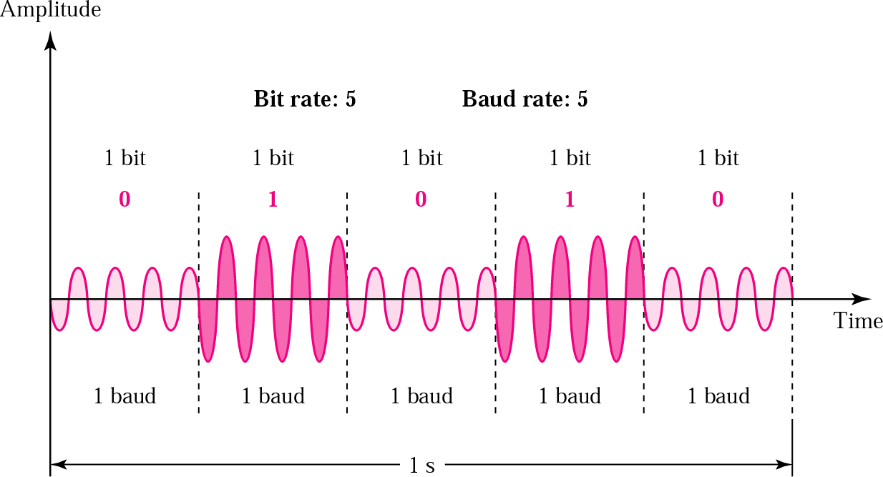
Figure 5.3 ASK

Slide 29
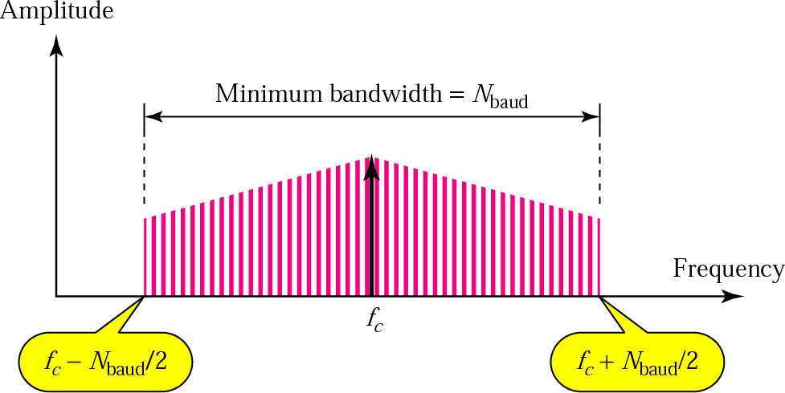
Figure 5.4
Relationship between baud rate and bandwidth in ASK

Slide 30
Example 3
Find the minimum bandwidth for an ASK signal transmitting at 2000 bps. The transmission mode is half- duplex.
Solution
In ASK the baud rate and bit rate are the same. The baud rate is therefore 2000. An ASK signal requires a minimum bandwidth equal to its baud rate. Therefore, the minimum bandwidth is 2000 Hz.

Slide 31
Example 4
Given a bandwidth of 5000 Hz for an ASK signal, what are the baud rate and bit rate?
Solution
In ASK the baud rate is the same as the bandwidth, which means the baud rate is 5000. But because the baud rate and the bit rate are also the same for ASK, the bit rate is 5000 bps.

Slide 32
Example 5
Given a bandwidth of 10,000 Hz (1000 to 11,000 Hz), draw the full-duplex ASK diagram of the system. Find the carriers and the bandwidths in each direction. Assume there is no gap between the bands in the two directions.
Solution
For full-duplex ASK, the bandwidth for each direction is BW = 10000 / 2 = 5000 Hz
The carrier frequencies can be chosen at the middle of each band (see Fig. 5.5).
fc (forward) = 1000 + 5000/2 = 3500 Hz fc (backward) = 11000 – 5000/2 = 8500 Hz

Slide 33
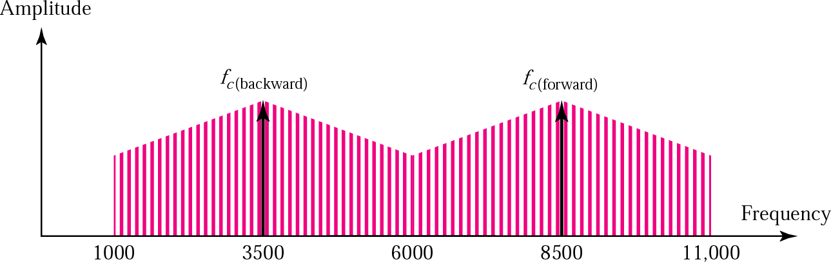
Figure 5.5
Solution to Example 5

Slide 34
Binary Frequency Shift Keying
• Most common form is binary FSK (BFSK)
• Two binary values represented by two different
frequencies (near carrier)
• Less susceptible to error than ASK
• Up to 1200bps on voice grade lines
• High frequency radio
• Even higher frequency on LANs using co-ax

Slide 35
Multiple FSK
• More than two frequencies used
• More bandwidth efficient
• More prone to error
• Each signalling element represents more than
one bit

Slide 36
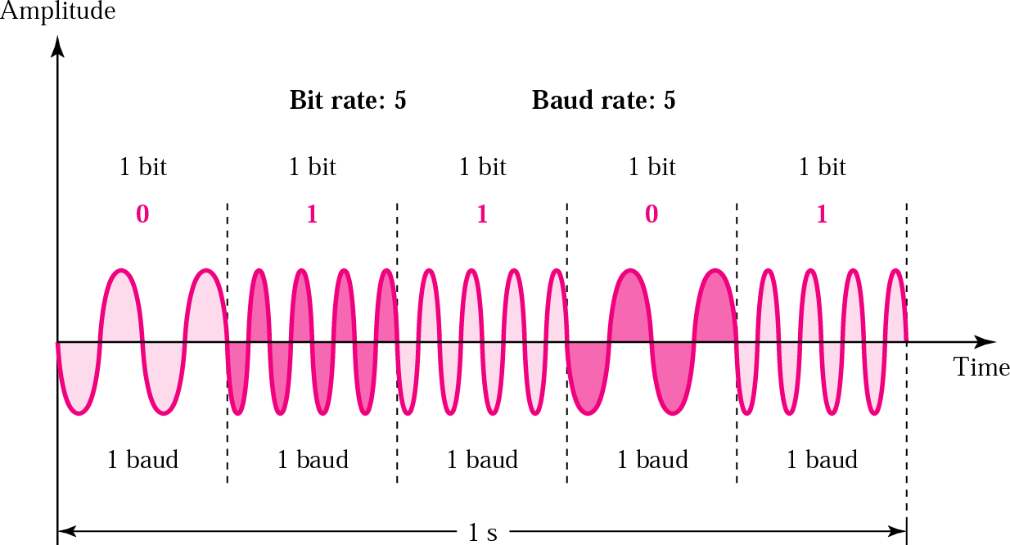
Figure 5.6 FSK

Slide 37
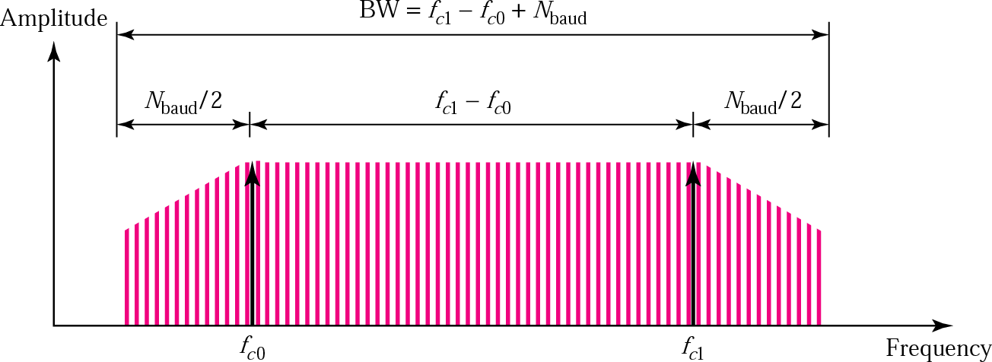
Figure 5.7
Relationship between baud rate and bandwidth in FSK

Slide 38
Example 6
Find the minimum bandwidth for an FSK signal transmitting at 2000 bps. Transmission is in half-duplex mode, and the carriers are separated by 3000 Hz.
Solution
For FSK
BW = baud rate +
^{f}c1 ^{− f}c0
BW = bit rate + fc1 − fc0 = 2000 + 3000 = 5000 Hz

Slide 39
Example 7
Find the maximum bit rates for an FSK signal if the bandwidth of the medium is 12,000 Hz and the difference between the two carriers is 2000 Hz. Transmission is in full-duplex mode.
Solution
Because the transmission is full duplex, only 6000 Hz is allocated for each direction.
BW = baud rate + fc1 − fc0
Baud rate = BW − (fc1 − fc0 ) = 6000 − 2000 = 4000 But because the baud rate is the same as the bit rate, the bit rate is 4000 bps.

Slide 40
Phase Shift Keying
• Phase of carrier signal is shifted to represent
data
• Binary PSK
—Two phases represent two binary digits
• Differential PSK
—Phase shifted relative to previous transmission rather
than some reference signal

Slide 41
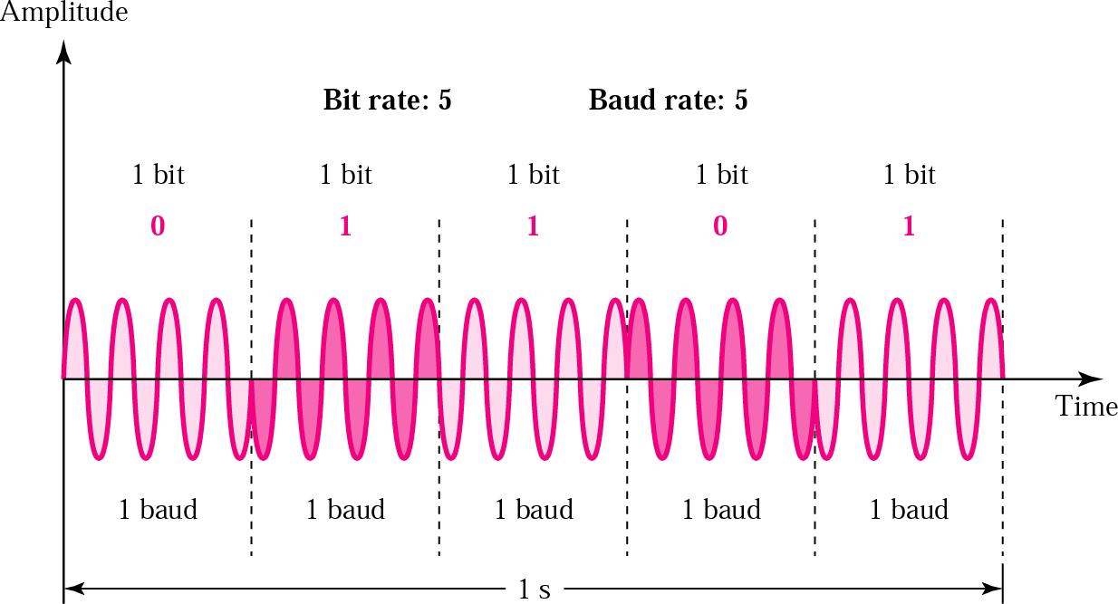
Figure 5.8 PSK

Slide 42
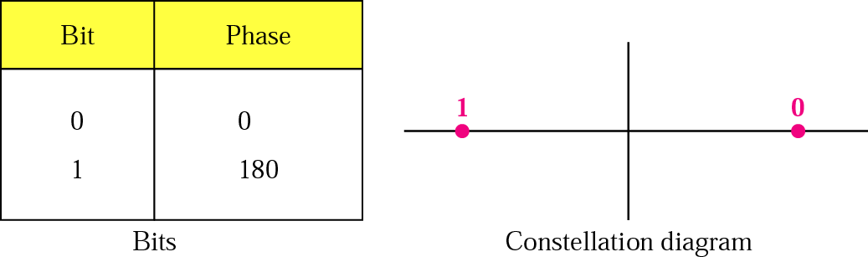
Figure 5.9
PSK constellation

Slide 43
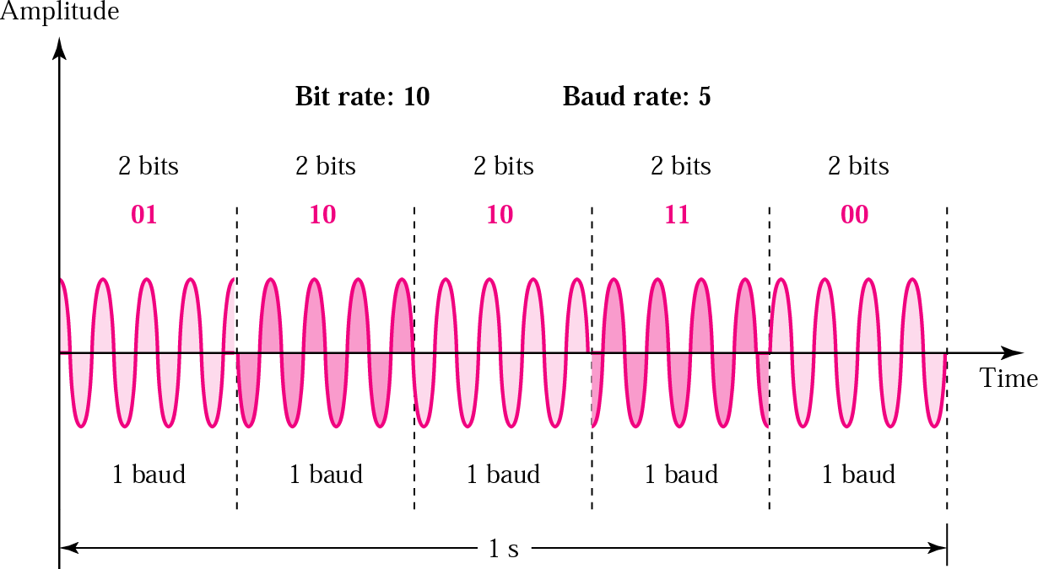
Figure 5.10
The 4-PSK method

Slide 44
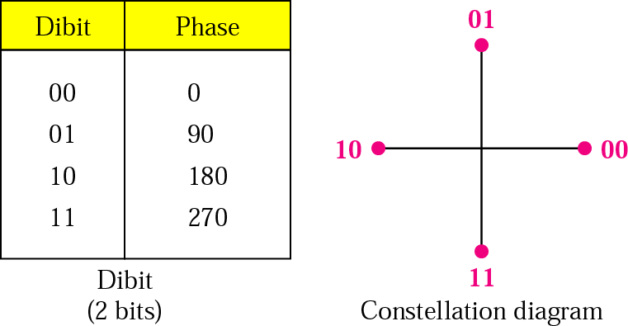
Figure 5.11
The 4-PSK characteristics

Slide 45
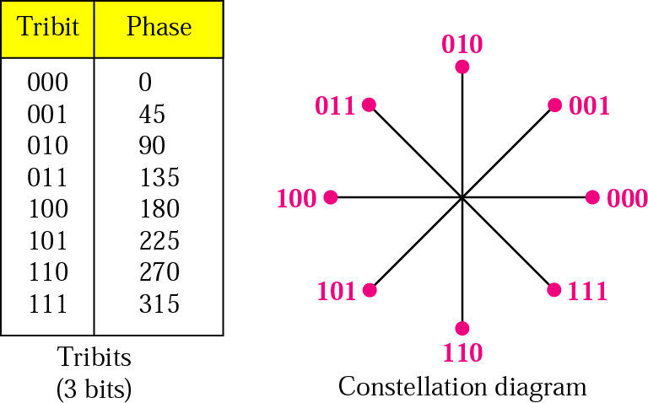
Figure 5.12
The 8-PSK characteristics

Slide 46
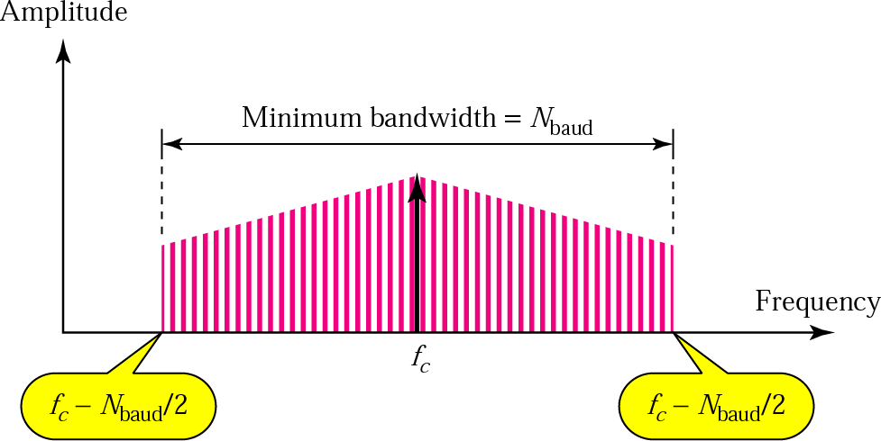
Figure 5.13
Relationship between baud rate and bandwidth in PSK

Slide 47
Example 8
Find the bandwidth for a 4-PSK signal transmitting at 2000 bps. Transmission is in half-duplex mode.
Solution
For PSK the baud rate is the same as the bandwidth, which means the baud rate is 5000. But in 8-PSK the bit rate is 3 times the baud rate, so the bit rate is 15,000 bps.

Slide 48
Example 9
Given a bandwidth of 5000 Hz for an 8-PSK signal, what are the baud rate and bit rate?
Solution
For PSK the baud rate is the same as the bandwidth, which means the baud rate is 5000. But in 8-PSK the bit rate is 3 times the baud rate, so the bit rate is 15,000 bps.

Slide 49
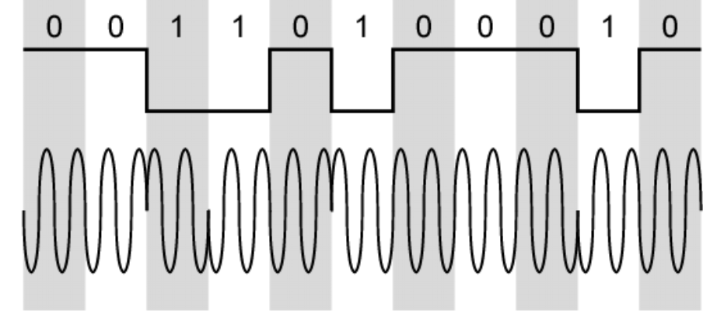
Differential PSK

Slide 50
Quadrature PSK
• More efficient use by each signal element
representing more than one bit
—e.g. shifts of /2 (90 )
o
—Each element represents two bits
—Can use 8 phase angles and have more than one
amplitude
—9600bps modem use 12 angles , four of which have
two amplitudes
• Offset QPSK (orthogonal QPSK)
—Delay in Q stream

Slide 51
Performance of Digital to
Analog Modulation Schemes
• Bandwidth
—ASK and PSK bandwidth directly related to bit rate
—FSK bandwidth related to data rate for lower
frequencies, but to offset of modulated frequency
from carrier at high frequencies
—(See Stallings for math)
• In the presence of noise, bit error rate of PSK
and QPSK are about 3dB superior to ASK and
FSK

Slide 52
Quadrature Amplitude
Modulation
• QAM used on asymmetric digital subscriber line
(ADSL) and some wireless
• Combination of ASK and PSK
• Logical extension of QPSK
• Send two different signals simultaneously on
same carrier frequency
—Use two copies of carrier, one shifted 90
°
—Each carrier is ASK modulated
—Two independent signals over same medium
—Demodulate and combine for original binary output

Slide 53
QAM Levels
• Two level ASK
—Each of two streams in one of two states
—Four state system
—Essentially QPSK
• Four level ASK
—Combined stream in one of 16 states
• 64 and 256 state systems have been
implemented
• Improved data rate for given bandwidth
—Increased potential error rate

Slide 54
Note:
Quadrature amplitude modulation is a combination of ASK and PSK so that a maximum contrast between each signal unit (bit, dibit, tribit, and so on) is achieved.

Slide 55
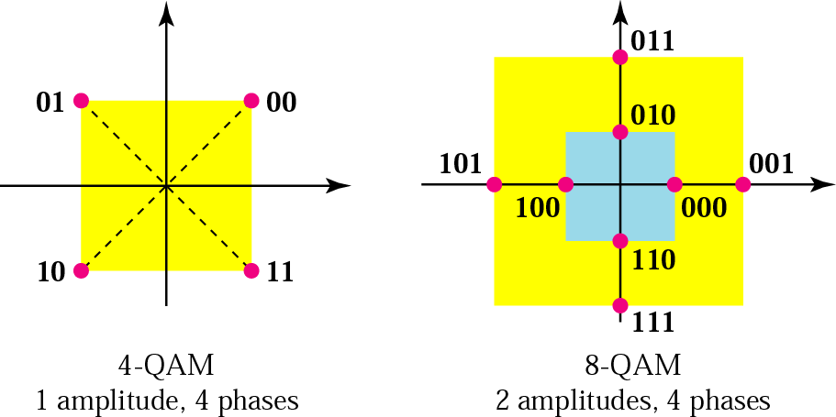
Figure 5.14
The 4-QAM and 8-QAM constellations

Slide 56
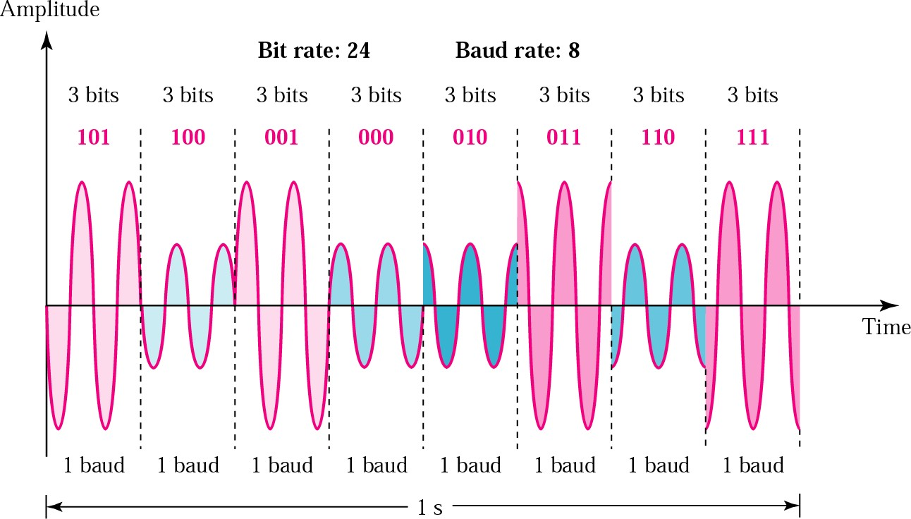
Figure 5.15
Time domain for an 8-QAM signal

Slide 57
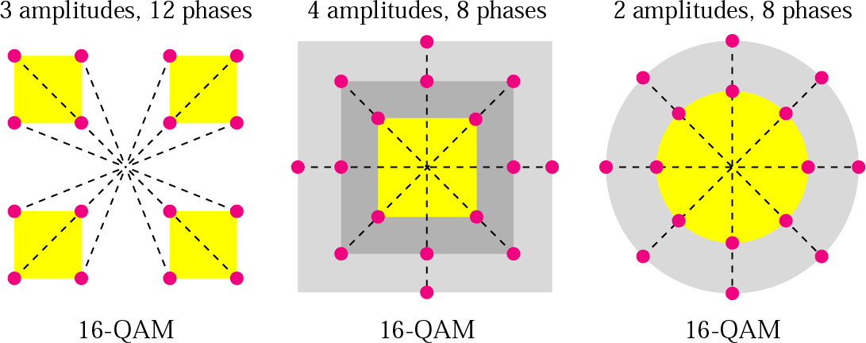
Figure 5.16
16-QAM constellations

Slide 58
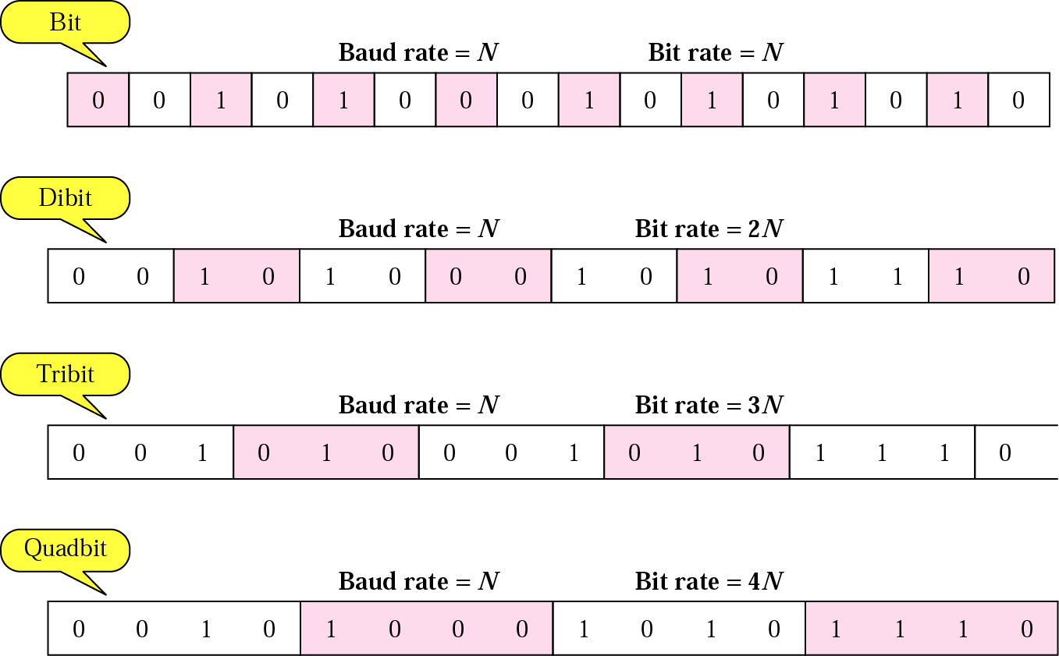
Figure 5.17
Bit and baud

Slide 59
Table 5.1 Bit and baud rate comparison
Modulation | Units | Bits/Baud | Baud rate | Bit Rate
ASK, FSK, 2-PSK | Bit | 1 | N | N
4-PSK, 4-QAM | Dibit | 2 | N | 2N
8-PSK, 8-QAM | Tribit | 3 | N | 3N
16-QAM | Quadbit | 4 | N | 4N
32-QAM | Pentabit | 5 | N | 5N
64-QAM | Hexabit | 6 | N | 6N
128-QAM | Septabit | 7 | N | 7N
256-QAM | Octabit | 8 | N | 8N

Slide 60
Example 10
A constellation diagram consists of eight equally spaced points on a circle. If the bit rate is 4800 bps, what is the baud rate?
Solution
The constellation indicates 8-PSK with the points 45 degrees apart. Since 2³ = 8, 3 bits are transmitted with each signal unit. Therefore, the baud rate is
4800 / 3 = 1600 baud

Slide 61
Example 11
Compute the bit rate for a 1000-baud 16-QAM signal.
Solution
A 16-QAM signal has 4 bits per signal unit since log₂16 = 4.
Thus,
(1000)(4) = 4000 bps

Slide 62
Example 12
Compute the baud rate for a 72,000-bps 64-QAM signal.
Solution
A 64-QAM signal has 6 bits per signal unit since
log₂ 64 = 6.
Thus,
72000 / 6 = 12,000 baud

Slide 63
Analog Data, Digital Signal
• Digitization
—Conversion of analog data into digital data
—Digital data can then be transmitted using NRZ-L
—Digital data can then be transmitted using code other
than NRZ-L
—Digital data can then be converted to analog signal
—Analog to digital conversion done using a codec
—Pulse code modulation
—Delta modulation

Slide 64
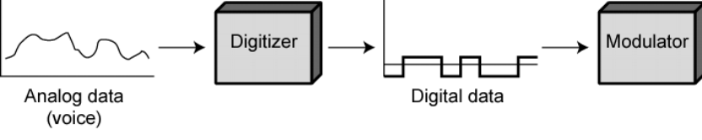
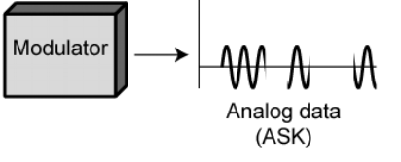
Digitizing Analog Data

Slide 65
Pulse Code Modulation(PCM) (1)
• If a signal is sampled at regular intervals at a
rate higher than twice the highest signal
frequency, the samples contain all the
information of the original signal
—(Proof - Stallings appendix 4A)
• Voice data limited to below 4000Hz
• Require 8000 sample per second
• Analog samples (Pulse Amplitude Modulation,
PAM)
• Each sample assigned digital value

Slide 66
Pulse Code Modulation(PCM) (2)
• 4 bit system gives 16 levels
• Quantized
—Quantizing error or noise
—Approximations mean it is impossible to recover
original exactly
• 8 bit sample gives 256 levels
• Quality comparable with analog transmission
• 8000 samples per second of 8 bits each gives
64kbps

Slide 67
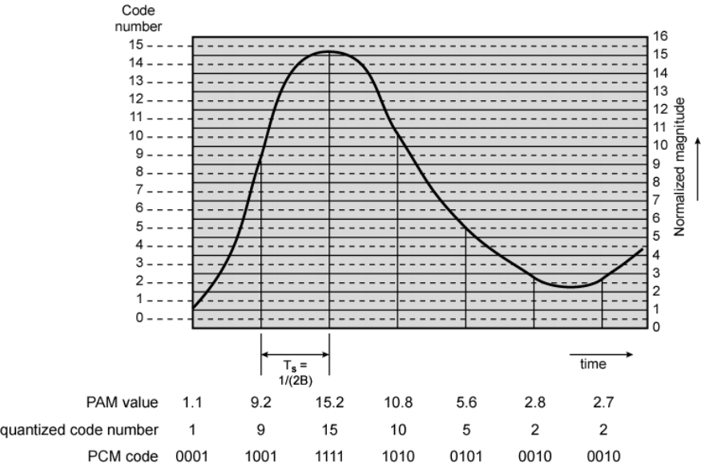
PCM Example

Slide 68
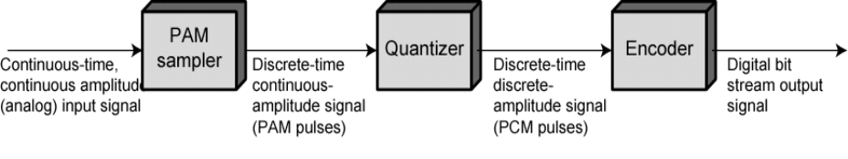
PCM Block Diagram

Slide 69
Nonlinear Encoding
• Quantization levels not evenly spaced
• Reduces overall signal distortion
• Can also be done by companding

Slide 70
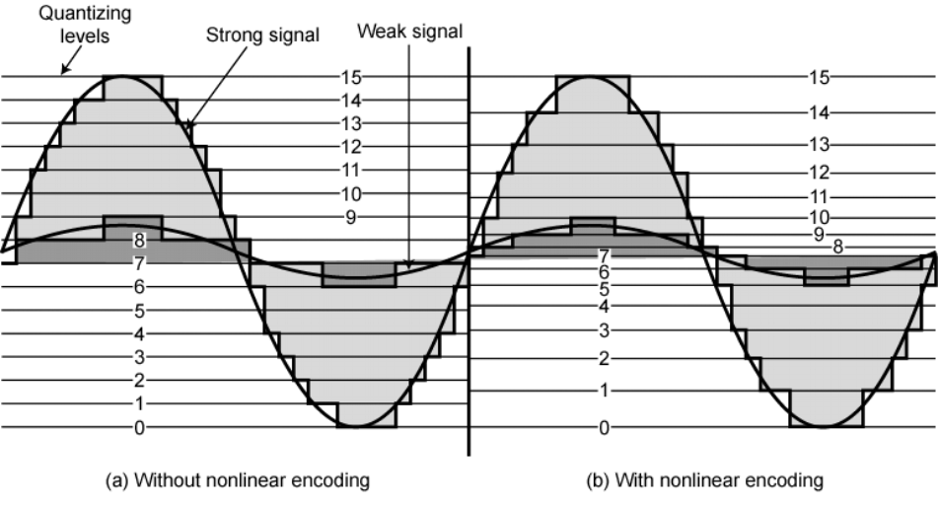
Effect of Non-Linear Coding

Slide 71
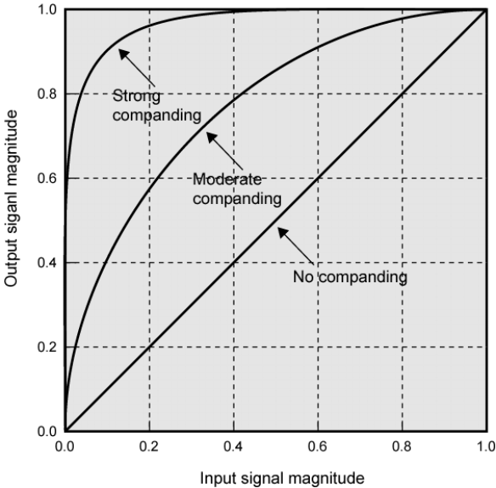
Typical Companding Functions

Slide 72
Delta Modulation
• Analog input is approximated by a staircase
function
• Move up or down one level () at each sample
interval
• Binary behavior
—Function moves up or down at each sample interval

Slide 73
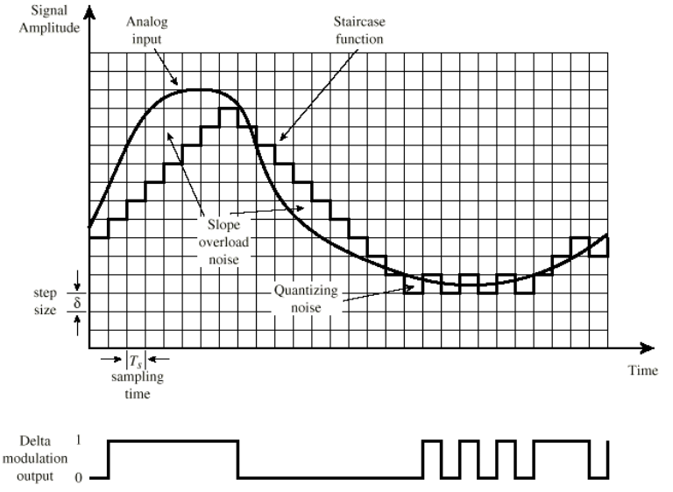
Delta Modulation - example

Slide 74
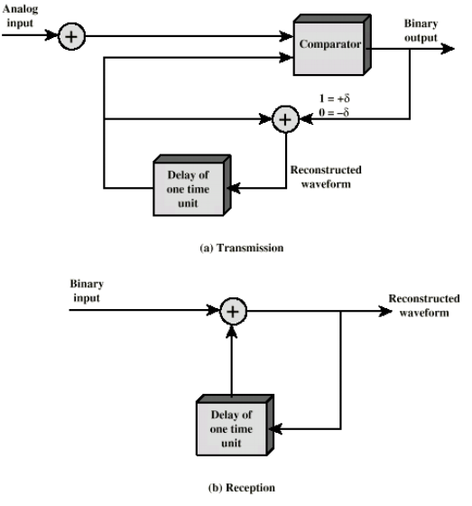
Delta Modulation - Operation

Slide 75
Delta Modulation - Performance
• Good voice reproduction
—PCM - 128 levels (7 bit)
—Voice bandwidth 4khz
—Should be 8000 x 7 = 56kbps for PCM
• Data compression can improve on this
—e.g. Interframe coding techniques for video

Slide 76
Analog Data, Analog Signals
• Why modulate analog signals?
—Higher frequency can give more efficient transmission
—Permits frequency division multiplexing (chapter 8)
• Types of modulation
—Amplitude
—Frequency
—Phase

Slide 77
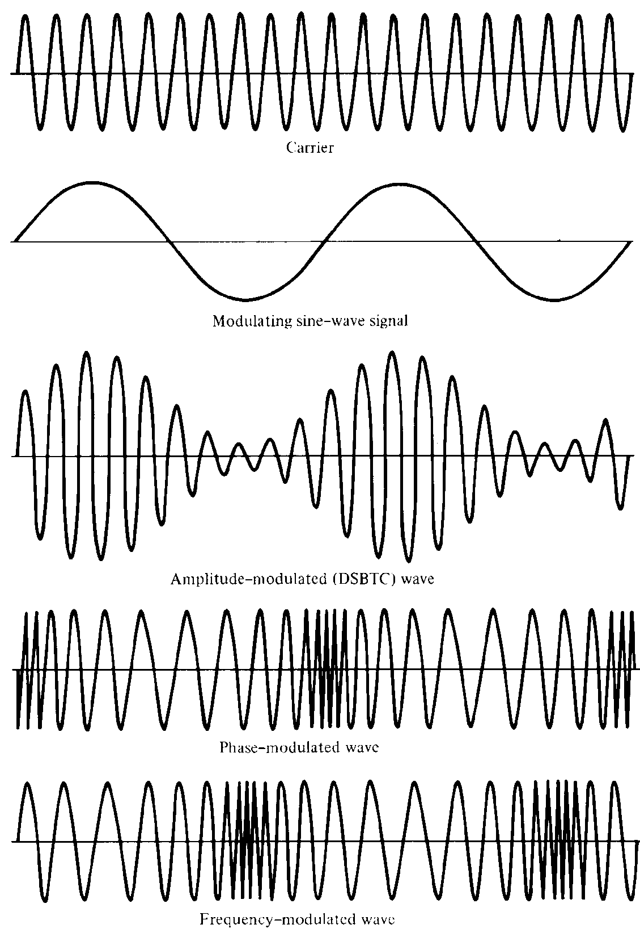
Analog
Modulation

Slide 78
Note:
The total bandwidth required for AM can be determined from the bandwidth of the audio signal:
BWt = 2 x BWm.

Slide 79
Example 13
We have an audio signal with a bandwidth of 4 KHz. What is the bandwidth needed if we modulate the signal using AM? Ignore FCC regulations.
Solution
An AM signal requires twice the bandwidth of the original signal:
BW = 2 x 4 KHz = 8 KHz

Slide 80
Note:
The total bandwidth required for FM can be determined from the bandwidth of the audio signal:
BWt = 10 x BWm.

Slide 81

Note:
The bandwidth of a stereo audio signal is usually 15 KHz. Therefore, an FM station needs at least a bandwidth of 150 KHz. The FCC requires the minimum bandwidth to be at least 200 KHz (0.2 MHz).

Slide 82
Example 14
We have an audio signal with a bandwidth of 4 MHz. What is the bandwidth needed if we modulate the signal using FM? Ignore FCC regulations.
Solution
An FM signal requires 10 times the bandwidth of the original signal:
BW = 10 x 4 MHz = 40 MHz

